Slide 1

Business Startup

Slide 2

Introduction
India has been very active in creating a healthy start up ecosystem, and the growth in the number of start ups is increasing year on year. In fact, it is among the top five start up communities in the world.

Slide 3
Introduction
Being so start up friendly the country has attracted numerous numbers of investors, both national and international. Therefore a large amount of money is poured into the start up ecosystem. Also due to government support, technology boon and rise of tier-2 and tier-3 cities has boosted the start up ecosystem.

Slide 4
Introduction
Events like launch of Start up India initiative, US elections and the Indian banknote demonetization had a huge impact on the start up community. The dataset acquired via kaggle.com will help to analyse the start up trends from start of 2015 to mid 2017 and how to above events have affected the trend.

Slide 5

Scope of analysis
The important investor of the Indian ecosystem.
The amount of funds does start up generally gets in India.
The roles of cities in funding.
How funding has changed overtime.

Slide 6

Business Model

Slide 7
We can help people decide the city where they should start up in.
We can help them figure out where to invest or the type of investment they should choose.

Slide 8
The amount of achievement that can be achieved.
We an also suggest people the type of industry they can choose.

Slide 9
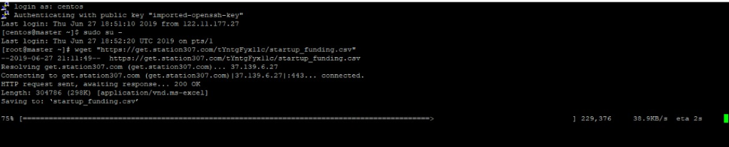

Slide 10
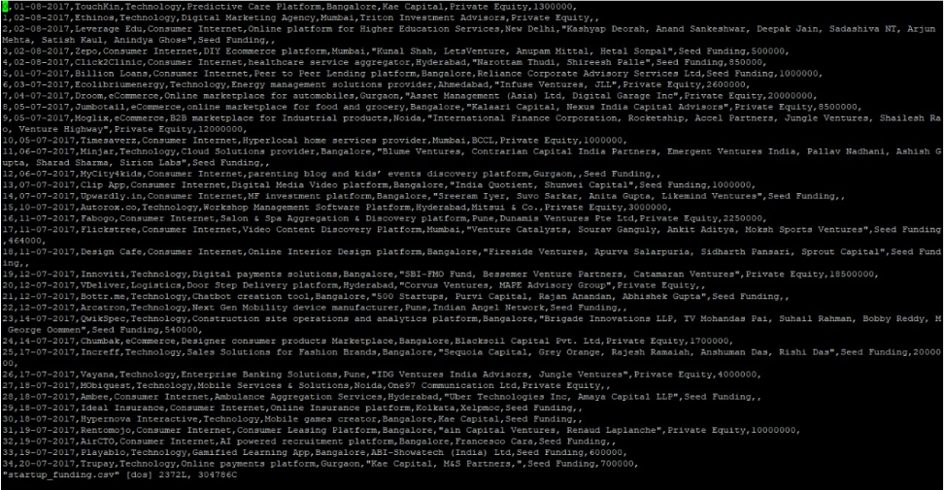

Slide 11
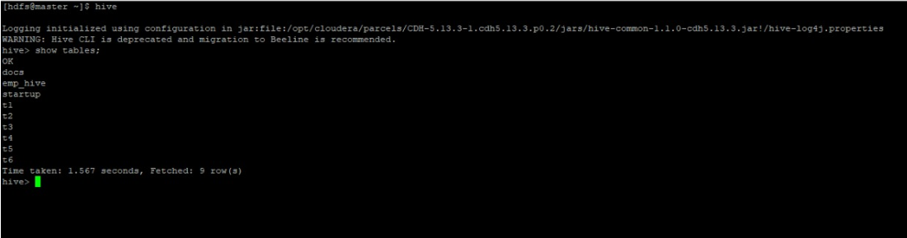
TABLE OF CONTENT

Slide 12
TABLE 1 - CODE

Slide 13
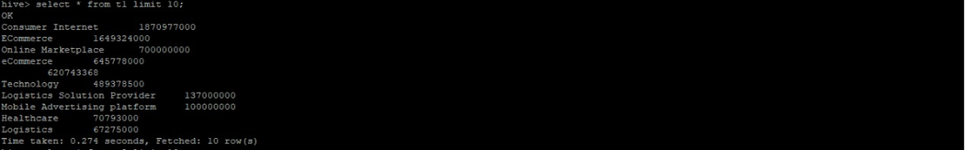
TABLE 1 - OUTPUT

Slide 14
TABLE 2 - CODE

Slide 15
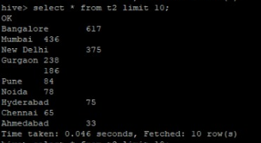
TABLE 2 - OUTPUT

Slide 16
TABLE 3 - CODE

Slide 17
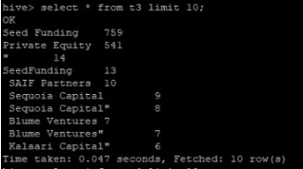
TABLE 3 - OUTPUT

Slide 18
TABLE 4 - CODE

Slide 19
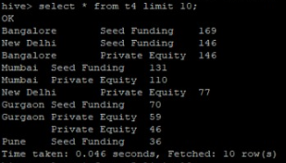
TABLE 4 - OUTPUT

Slide 20
TABLE 5 - CODE

Slide 21
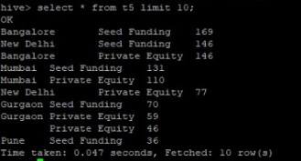
TABLE 5 - OUTPUT

Slide 22
TABLE 6 - CODE

Slide 23
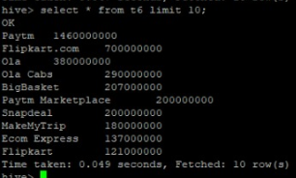
TABLE 6 - OUTPUT

Slide 24

Thank You

